Slide 1
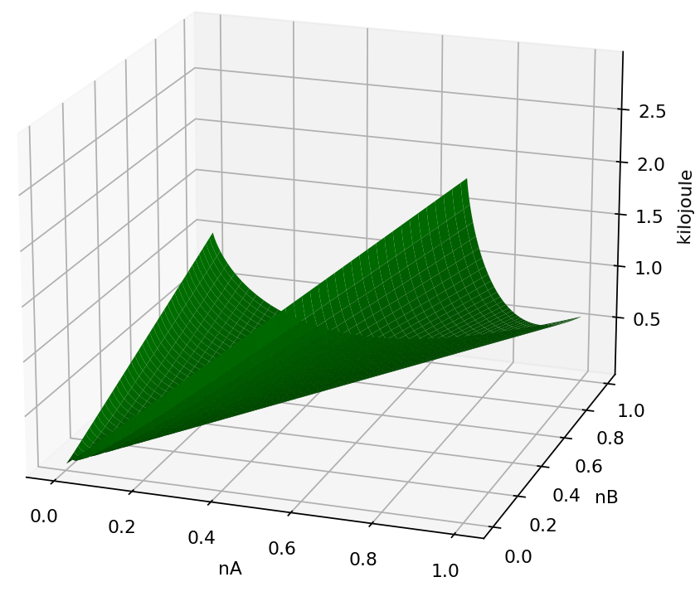
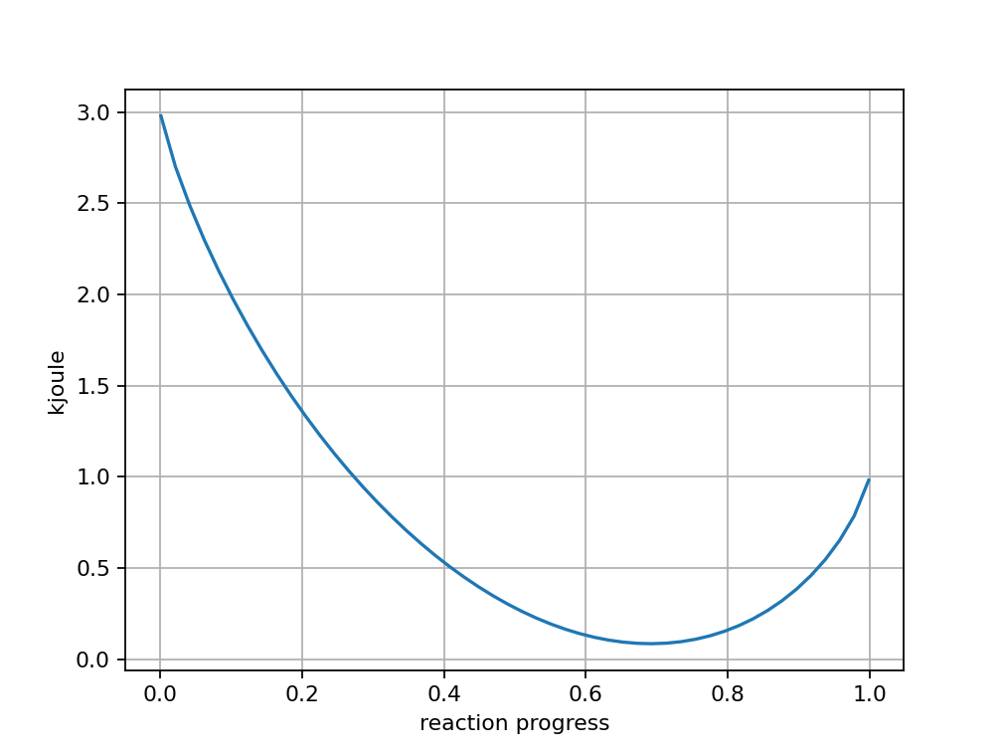

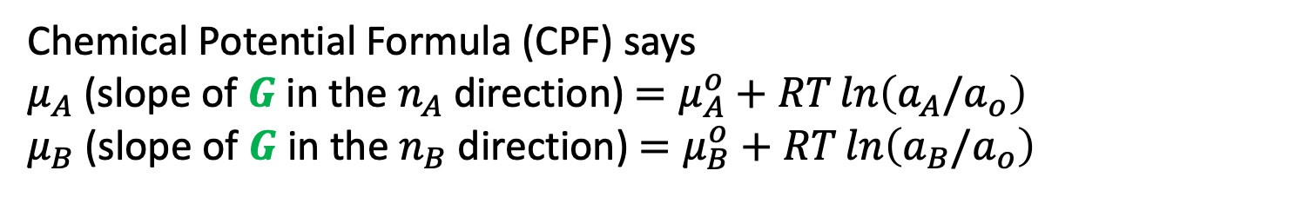




Recap
Chemical Potential Formula (CPF) says
$μ_{A}$(slope of $G$ in the $n_{A}$ direction) $=μ_{A}^{o}+RT\ln\left(a_{A}/a_{o}\right)$
$μ_{B}$(slope of $G$ in the $n_{B}$ direction) $=μ_{B}^{o}+RT\ln\left(a_{B}/a_{o}\right)$
$$G$$
$$G$$
${\left(\frac{∂G}{∂ε}\right)}_{rxn}$ $≡∆G_{rxn}\left(ε\right)$
$$ε$$
$$ε$$

Slide 2
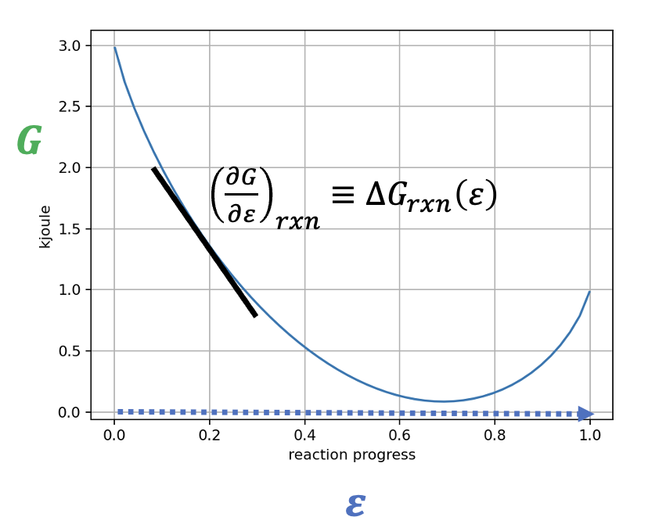
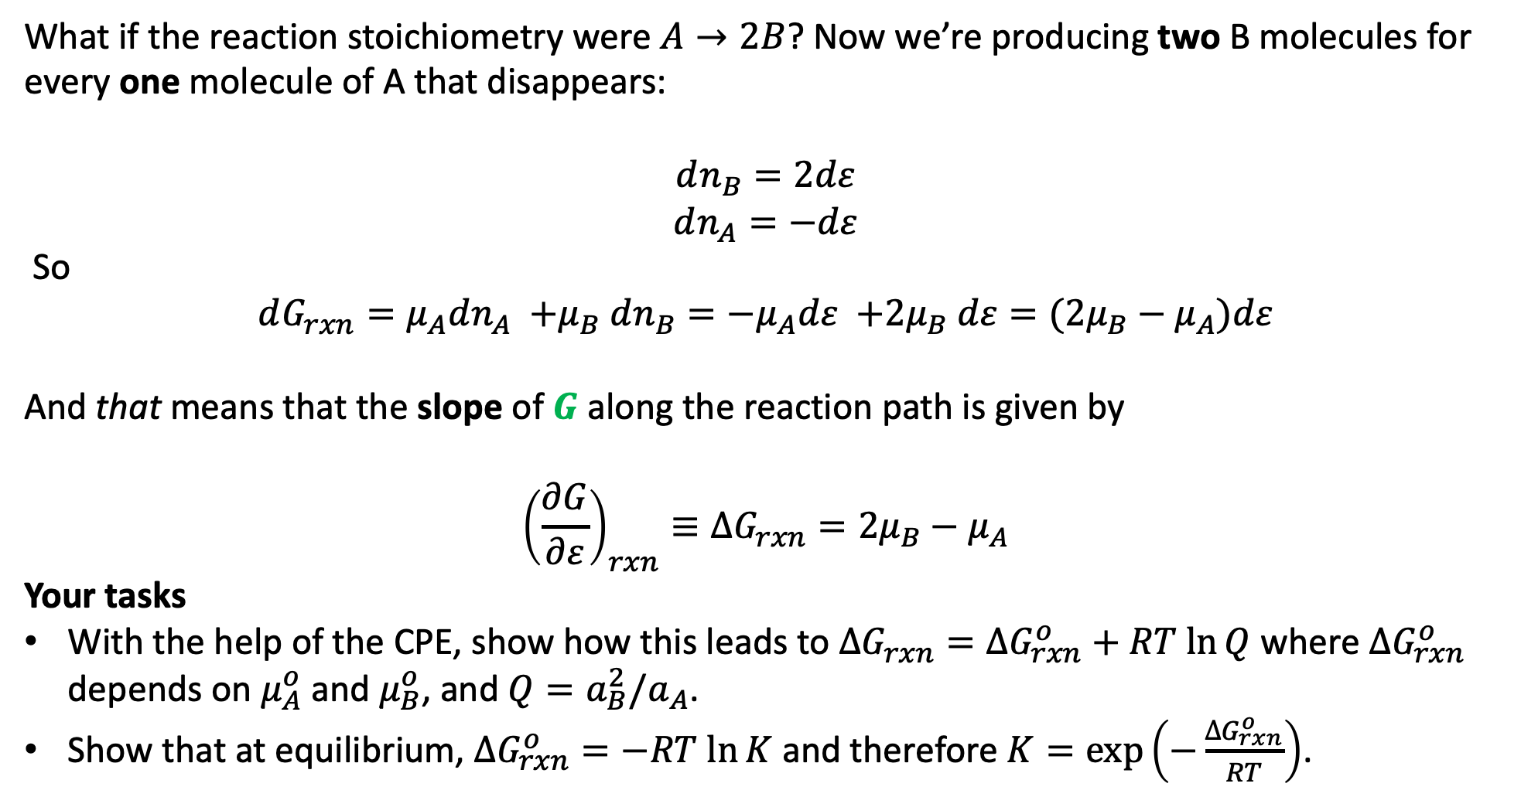
3. Generalizing the connection between $μ_{A}$, $μ_{B}$,${\left(\frac{∂G}{∂ε}\right)}_{rxn}≡∆G_{rxn}\left(ε\right)$, $Q$, and $K$
What if the reaction stoichiometry were $A→2B$? Now we’re producing two B molecules for every one molecule of A that disappears:
$$dn_{B}=2dε$$
$$dn_{A}=−dε$$
So
$$dG_{rxn}={μ_{A}dn_{A} {+μ}_{B}dn_{B}=−μ}_{A}dε {+2μ}_{B}dε=({2μ}_{B}−μ_{A})dε$$
And that means that the slope of $G$ along the reaction path is given by
$${\left(\frac{∂G}{∂ε}\right)}_{rxn}≡∆G_{rxn}={2μ}_{B}−μ_{A}$$
Your tasks
With the help of the CPE, show how this leads to $∆G_{rxn}=∆G_{rxn}^{o}+RT ln⁡Q$ where $∆G_{rxn}^{o}$ depends on $μ_{A}^{o}$ and $μ_{B}^{o}$, and $Q={a_{B}^{2}/a}_{A}$.
Show that at equilibrium, $∆G_{rxn}^{o}=−RT ln⁡K$ and therefore $K=\exp\left(−\frac{∆G_{rxn}^{o}}{RT}\right)$.

Slide 3
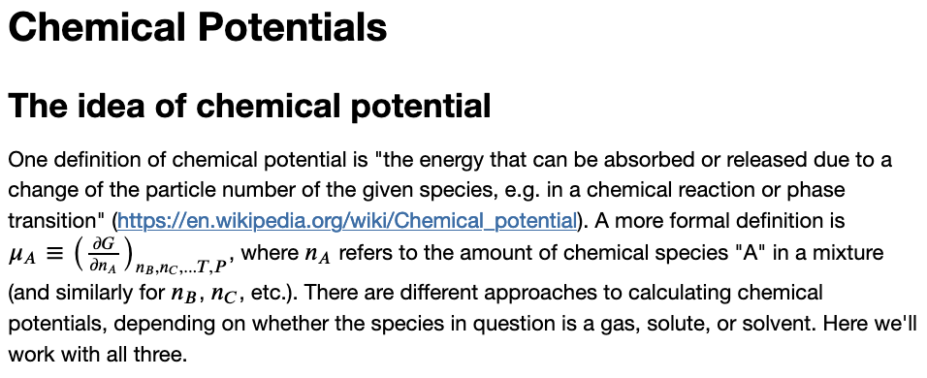
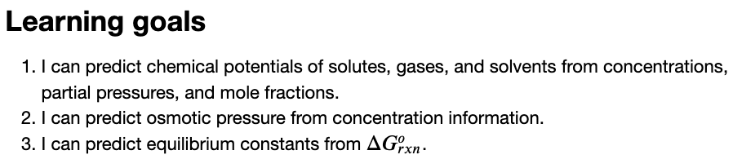
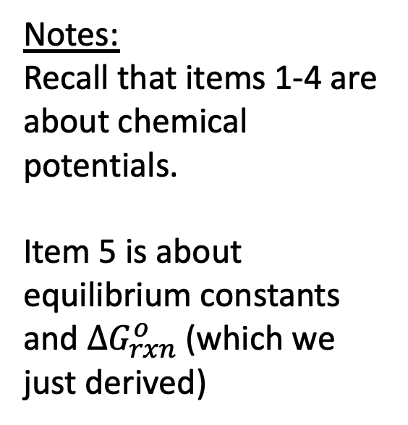
The CGI associated with this
Notes:
Recall that items 1-4 are about chemical potentials.
Item 5 is about equilibrium constants and $∆G_{rxn}^{o}$ (which we just derived)

